Slide 2
Start Free, Stay Free, AIDS Free -
Accelerating the Pediatric HIV Agenda
Chip Lyons
President & CEO
Elizabeth Glaser Pediatric AIDS Foundation

Slide 3
Global Plan* (2011-2015)
*Global Plan Towards the Elimination of New HIV Infections Among Children by 2015 and Keeping Their Mothers Alive, in 21 priority countries
Global Target #1 | Global Target #2
Reduce the number of new HIV infections among children by 90% | Reduce the number of AIDS-related maternal deaths by 50%
Progress achieved: Target #1 | Progress achieved: Target #2
New HIV infections among children reduced by 60% | AIDS-related deaths among women of reproductive age reduced by 43%

Slide 4
HLM Targets: 2018 and 2020
Target | 2018 | 2020
Start Free: New infections in children HIV+ pregnant women on ART (%) | <40,000 95% | <20,000 95%
Stay Free: New infections in adolescents/young women VMMC (men, focus on ages 15-29) |  | <100,000 25,000,000
AIDS Free: Children (age 0-14) on ART Adolescents (age 15-19) on ART Children on ART (%) | 1,600,000 1,200,000 95% | 1,400,000 1,000,000 95%

Slide 5
Ending AIDS Among Children, Adolescents and Young Women by 2020

Slide 6
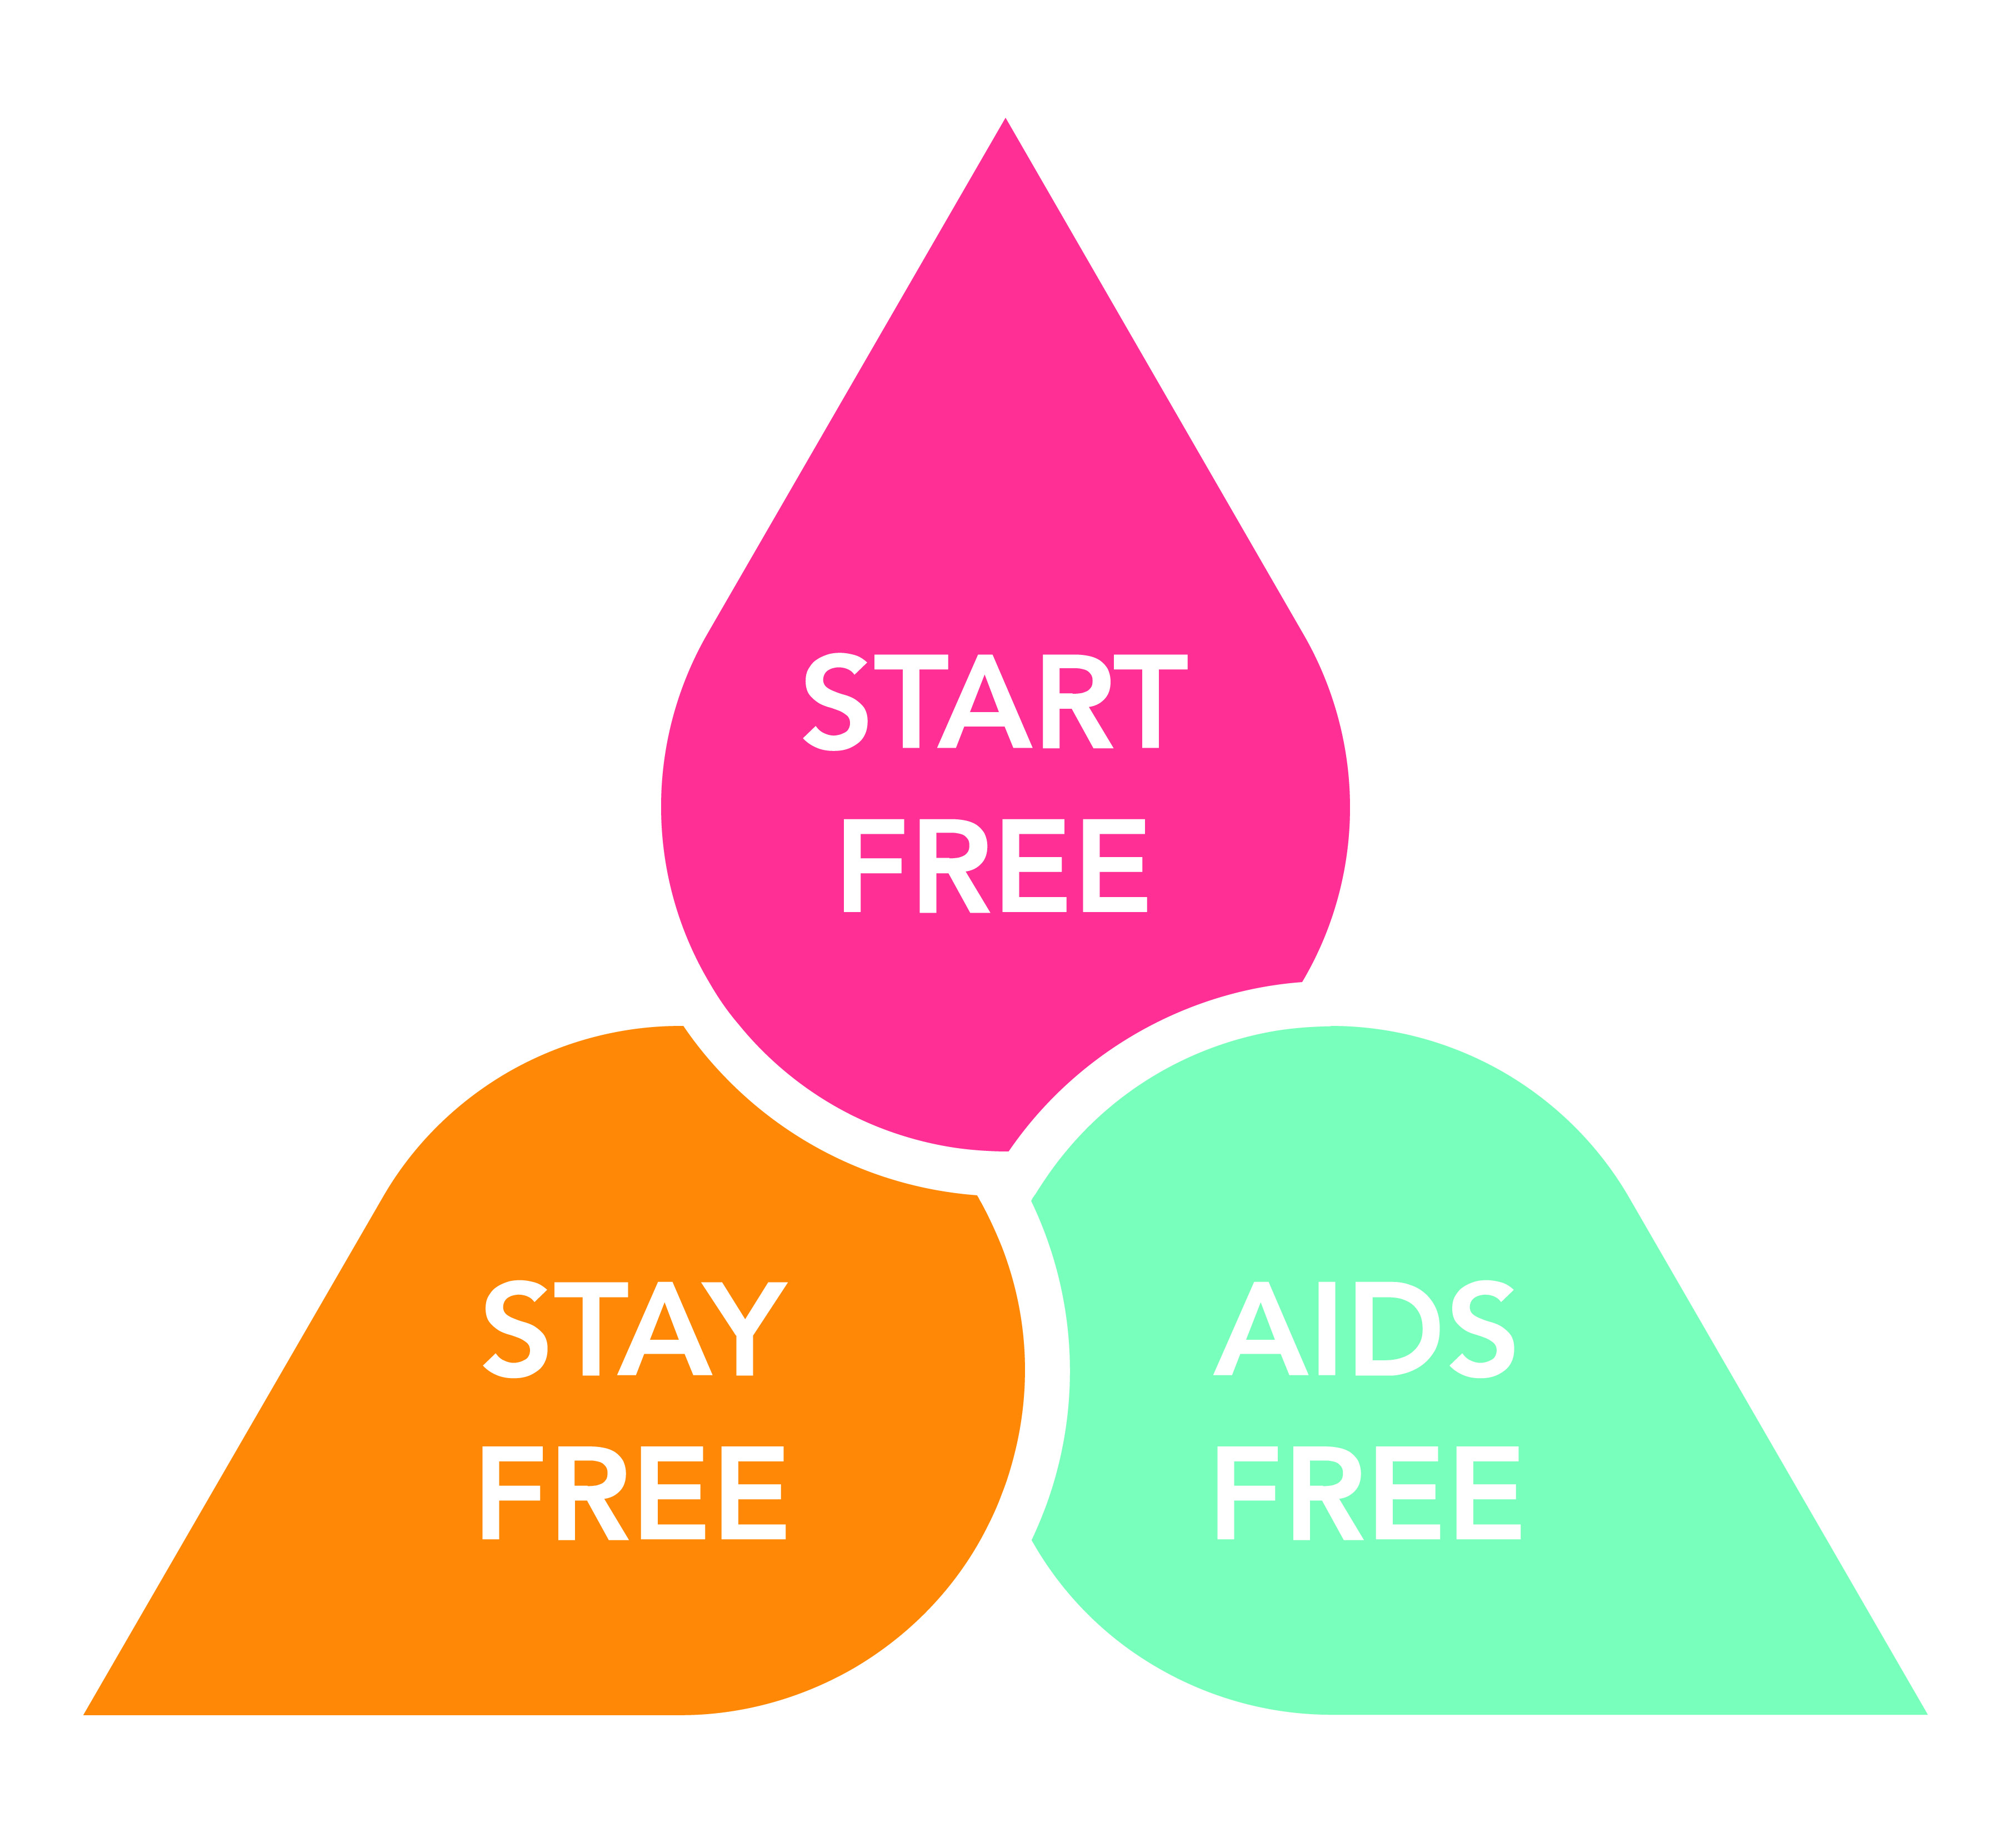
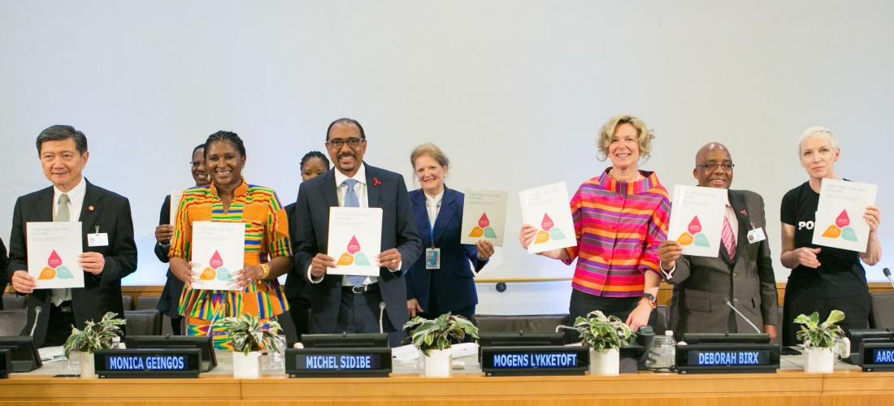
Accelerated Fast-Track Approach
Co-convened by UNAIDS and PEPFAR
Launched at the UN General Assembly High Level Meeting on HIV/AIDS (June 2016) & at AIDS 2016 in Durban (July 2016)
Builds upon the Global Plan 2011-2015, DREAMS, ACT

Slide 7
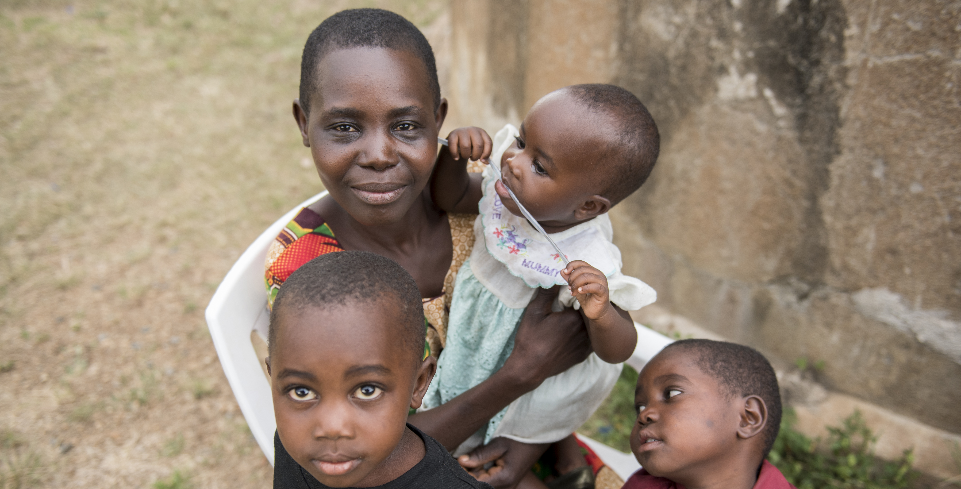
AIDS Free: Prioritizing actions that are most urgent to reach pediatric and adolescent treatment targets

Slide 8
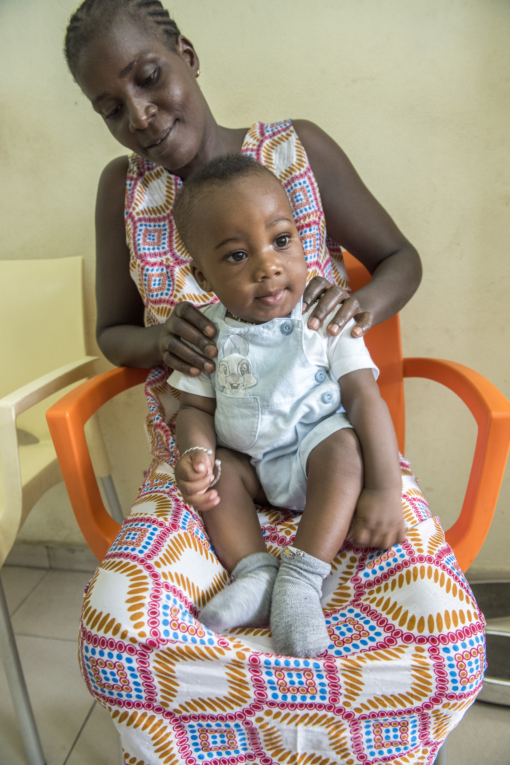
Country Consultations
High-level Ministerial Dialogue in Geneva (Dec 2016)
Convened by UNAIDS to engage political leaders (10+ Ministers of Health)
Ministerial Progress Review in Geneva (June 2017)
Convened by UNAIDS and PEPFAR to review progress against Start Free, Stay Free, AIDS Free targets
AIDS Free workshop in Cote d’Ivoire (December 2017)
Involved 21 countries on how to scale up timely diagnosis, treatment and care for children and adolescents

Slide 9
Rome Action Plan for Scaling Up Early Diagnosis and Treatment of Children and Adolescents
November 2017 set of concrete commitments among stakeholders from the public, private, intergovernmental, and non-profit sectors centered around the need to:
focus in on a limited set of priority formulations for children (the “PADO list”);
accelerate their development, approval, and roll-out; and
collaborate more closely on the technical, financial, and political elements of pediatric ARV R&D and uptake.

Slide 10
We are not on track
*UNAIDS 2018 Global AIDS Update “Miles to Go”

